Slide 1
Uganda KP layering table
& program cascade

Slide 2
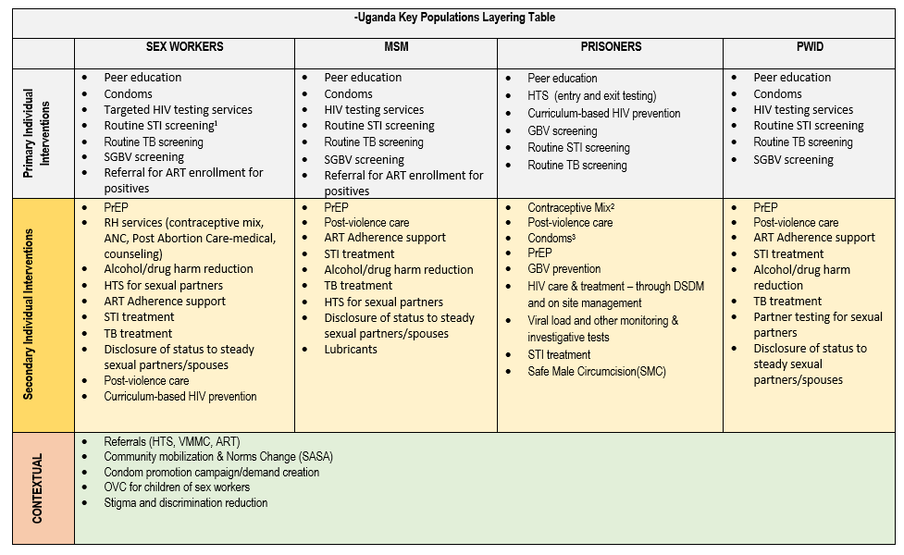
KP Layering table

Slide 3







Progress in Prevention and clinical cascade monitoring
Human rights
Supportive laws
Zero violence tolerance
FY18 Inter-Agency Collaborative for Program improvement (ICPI KP Tool)
Scale, speed & Quality
Prevention
HIV-
HIV+
Identify Key populations
Reach Key populations
Same day ART
Earliest access and adherence to ART for HIV-positive KPs upon diagnosis and in support to treatment as prevention
Continuous re-engagement with HIV-negative KPs on combination prevention (access to condoms, lubricants, PrEP)
Community mobilization and engagement

